Slide 1
Depth – First Traversal
We have to consider three tasks in this type
V – visiting a node
L – traversing the left sub-tree if any
R – traversing the right sub-tree if any
There are six types of depth–first traversal, but we will consider three of them:
VLR ( Preorder )
LVR ( Inorder )
LRV ( Postorder)

Slide 2
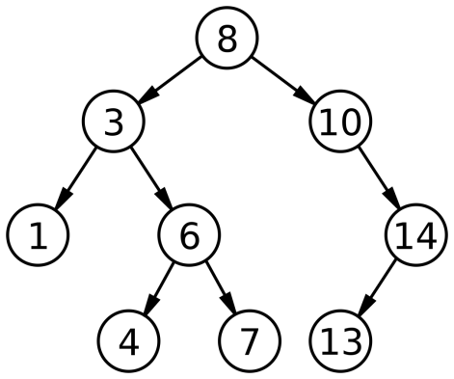
VLR ( Preorder )
VLR
Assuming that the visit(v) is to output
the value
VLR
VLR
VLR
VLR
VLR
VLR
VLR
VLR
Output : 8 ,3 ,1 ,6 ,4 ,7 ,10 ,14 ,13

Slide 3
LVR ( Ineorder )
LVR
Assuming that the visit() is to output
the value
LVR
LVR
LVR
LVR
LVR
LVR
LVR
LVR
Output : 1 , 3 , 4 , 6 , 7 , 8 ,10 ,13 ,14

Slide 4
LRV ( Posteorder )
LRV
Assuming that the visit() is to output
the value
LRV
LRV
LRV
LRV
LRV
LRV
LRV LRV
Output : 1 , 4 , 7 ,6 ,3 , 13 , 14 , 10 , 8

